Slide 1


BE Project Presentation On “Cyberbullying Detection in Social Media Using Supervised ML & NLP Techniques”
Presented by
Student Name Roll No
Anklesh Patil 19U371
Anuj Patil 19U372
Gayatri Battise 19U339
Jivan Devhare 19U357
Guided By
Guide Name
Prof. Dr. K.N.Honwadkar

Slide 2
Outline
Problem Statement
Introduction
Motivation
Literature Survey
Gap Analysis
problem statement
Objectives
Social Impact (Applications)
System Architecture
Data flow diagram
Feasibility and Scope
- Software and Hardware requirement
- Project Timeline
Project Modules
Proposed System
Advantages and Limitations
Conclusion
References

Slide 3
DOMAIN INTRODUCTION
Data mining is the computing process of discovering patterns in large datasets involving methods at the intersection of machine learning, statistics and database systems.
The overall goal of the data mining process is to extract information from a data set and transform it into an understandable structure for further use.
Data mining is the analysis step of the "knowledge discovery in databases" process, or KDD.
Data mining is about finding new information in a lots of data.
The information obtained from data mining is hopefully both new and useful.

Slide 4
INTRODUCTION
Social networking sites are being widely used today for multiple purposes like entertainment, networking, etc. Social networking sites are a stop for multiple reasons to billions of people today.
Communicating with people is no exception, as technology has changed the way people interact with a broader manner and has given a new dimension to communication. Many people are illegally using these communities. Many youngsters are getting bullied these days. Bullies use various services like Twitter, Facebook, and Email to bully people.
Cyberbullying is one of the most frequently happen Internet abuse and also a very serious social problem especially for teenager
Thus, a complete solution is required for this problem. Cyberbullying needs to stop. The problem can be tackled by detecting and preventing it by using a machine learning approach

Slide 5
MOtivation
From the day internet came into existence, the era of social networking sprouted. In the beginning, no one may have thought internet would be a host of numerous amazing services like the social networking.
Today we can say that online applications and social networking websites have become a non-separable part of one’s life. Many people from diverse age groups spend hours daily on such websites.
Despite the fact that people are emotionally connected together through social media, these facilities bring along big threats with them such as cyber-attacks.
To identify word similarities in the tweets made by bullies and make use of machine learning and can develop an ML model automatically detect social media bullying actions.

Slide 6
LITERATURE SURVEY
Title | Year | Author | Methodology
Opinion Mining and Social Networks: a Promising Match | 2011 | K. Jedrzejewski and M. Morzy. | The role and importance of social networks in preferred environments for opinion mining and sentiment analysis. Selected properties of social networks that are relevant with respect to opinion mining are described and general relationships between the two disciplines are outlined. The related work and basic definitions used in opinion mining is given.

Slide 7
LITERATURE SURVEY
Title | Year | Author | Methodology
Using Machine Learning to Detect Cyberbullying | 2011 | Kelly Reynolds, April Kontostathis, Lynne Edwards | Cyberbullying is the use of technology as a medium to bully someone. It has been an issue for many years, the recognition of its impact on young people has recently increased. Social networking sites provide a fertile medium for bullies, and teens and young adults who use these sites are vulnerable to attacks. Through machine learning, we can detect language patterns.
5/10/2022

Slide 8
LITERATURE SURVEY
Title | Year | Author | Methodology
Detecting Offensive Language in Social Media to Protect Adolescent Online Safety. | 2012 | Ying Chen, Yilu Zhou, Sencun Zhu, and Heng Xu | user-level offensiveness detection seems a more feasible approach. so, the Lexical Syntactic Feature (LSF) architecture is used to detect offensive content and identify potential offensive users in social media. We distinguish the contribution of pejoratives/profanities and obscenities in determining offensive content, and introduce hand-authoring syntactic rules in identifying name-calling harassments

Slide 9
LITERATURE SURVEY
Title | Year | Author | Methodology
Analyzing Labelled Cyberbullying Incidents on the Instagram Social Network. | 2015 | H. Hosseinmardi, S. A. Mattson, R. I. Rafiq, R. Han, Q. Lv, and S. Mishra. | Cyberbullying is a growing problem affecting more than half teens. The main goal is to study cyberbullying incidents in the social network. In this work, we have collected a sample data and their associated comments. We then designed a study and employed human contributors at the crowd-sourced Crowd Flower website to label these media sessions for cyberbullying.
5/10/2022

Slide 10
gap analysis
Cyberbullying incidents are increasing day by day as technology rolls out.
A large number of cyberbullying incidents are reported by companies each year.
The existing system to detect cyberbullying on social media doesn’t effectively classify and predict the tweets which are presented in the social media.

Slide 11
Problem statement
We are interested in building a software application for detecting bullying instances in social media. We are focusing on bulling detection for social reasons, which range from reducing the number of suicides caused by bullying, to making microblogging a no bullying zone.

Slide 12
OBJECTIVE
To provide an innovative preventative strategy that enables fast and accurate detection of cyberbullying case.
To effectively classify and predict the data.
To decrease sparsity problem.
To enhance the performance of the overall prediction results.

Slide 13
Social Impact
Mental and physical effects, Cyberbullying leads to the increase of stress along with this it increased the anger in a person. People used to feel frustrated
Feel alone and isolated- Most of the victims of cyberbullying feel alone as they have a fear of sharing the information they have feared to talk with a stranger.
Disinterested in attending college and schools- people who are suffering from cyberbullying are not interested to attend the classes as they don’t feel comfortable because of the embarrassment and humiliation between their fellow students which results to give a negative impact on their results.

Slide 14
SYSTEM ARCHITECTURE
Data set
Preprocessed data set
Vectorize method
Sentiment analysis
Test set
Train set
Classification
Prediction

Slide 15
FLOW DIAGRAM
Start
Select dataset
Preprocess dataset
Vectorize data
Sentiment analysis
Split train and test data
Classification
Prediction

Slide 16
SYSTEM REQUIREMENTS
Hardware Requirements
Hard Disk : 1000 GB
Monitor : 15 VGA color
Mouse : Microsoft.
Keyboard : 110 keys enhanced
RAM : 4GB

Slide 17
SYSTEM REQUIREMENTS
Software Requirements
Operating System : Windows 7
Language : Python
IDE : Anaconda - Spyder

Slide 18
Project Timeline
Complete the Debugging of the code
Analyzing overall Real-world case scenario
Topic Finalization
Calculating technical risk and social impact
Selecting proper algorithms
Jan 15
Aug15
Finalizing system Architecture
Dec 30
Mar 30
Oct 1
Fixing Bugs
Nov 1
Feb 15
Q4
2021
Q3
Q4
Q1 2022
Q2
Sep 15
Nov 15
Mar 1
Gathering
Prerequisites
Acquiring Datasets
Preparation of Report
Jan 30
Apr 15
Running Test Simulations
Submission
52 wks
01/09/2020
Phase I
15/12/2021
45 wks
20/12/2021
Phase II
30/03/2022
23.6 wks
15/02/2022
Phase III
15/04/2022

Slide 19

MODULES
Data Selection and Loading
Data Preprocessing
Splitting Dataset into Train and Test Data
Feature Extraction
Classification
Prediction
Result Generation

Slide 20
PROPOSED SYSTEM
The proposed model is a feature-based model that uses features from tweets contents to develop a machine learning classifier for classifying the tweets as cyberbullying or non-cyberbullying and its severity as low, medium, high or none.
This system will increase the accuracy of the supervised classification results by classifying the data. An approach is proposed for detecting and preventing cyberbullying using Supervised Binary classification Machine Learning algorithms.
Our model is evaluated on Naive Bayes. It enhances the performance of the overall classification results.

Slide 21
ADVANTAGES
Using ML techniques to predict cyberbullying produces high performance.
ML techniques like SVM and Naïve Bayes predicts the results accurately.
It avoid sparsity problems.
Reduces the information Loss and the bias of the inference due to the multiple estimates.

Slide 22
DISADVANTAGES
Doesn’t Efficient for handling large volume of data.
Data is inherently scarce in terms of public access
Incorrect Classification Results.
Less Prediction Accuracy

Slide 23
Test case 01
Aim: Analysis of comments on Mr. Donald Triumph’s tweets and find the negative and positive comments. So that we can check whether that parent tweet is getting positive or negative feedback from the public to identify the cyberbullying case.
Dataset: Dataset imported from Kaggle.com
Output:
Total No. of Tweets | Violent Tweets (in %) | Non-Violent Tweets
41122 | 24.7% | 75.3%

Slide 24
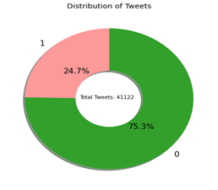
Result:
Out of the total of 41122 tweets done by the public on the Mr. Donal Triumphs tweet 24.7% are Violent(positive) tweets and 75.3% are non-violent.
This shows us there is no major activity of cyberbullying in this test case 01.
We are getting an accuracy 85%.
Graph:

Slide 25
Test case 02
Aim: Analysis of comments on NFT’’s tweets and find the negative and positive comments. So that we can check whether that parent tweet is getting positive or negative feedback from the public to identify the cyberbullying case.
Dataset: Dataset imported from Kaggle.com
Output:
Total No. of Tweets | Violent Tweets (in %) | Non-Violent Tweets
12452 | 10.1% | 89.6%

Slide 26
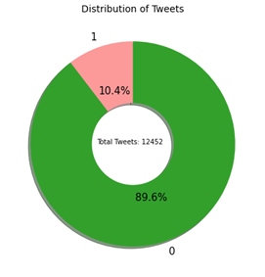
Result:
Out of the total of 12452 tweets done by the public on the NFT tweet 10.1% are Violent(positive) tweets and 89.6% are non-violent.
This shows us there is no major activity of cyberbullying in this test case 01.
We are getting an accuracy 94%.
Graph:

Slide 27
Test case 03
Aim: Analysis of comments on Corona tweets and find the negative and positive comments. So that we can check whether that parent tweet is getting positive or negative feedback from the public to identify the cyberbullying case.
Dataset: Dataset imported from Kaggle.com
Output:
Total No. of Tweets | Violent Tweets (in %) | Non-Violent Tweets
3798 | 42.7% | 57.3%

Slide 28
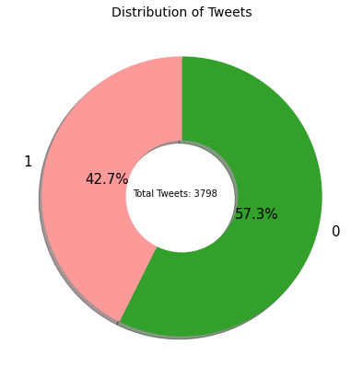
Result:
Out of the total of 3798 tweets done by the public on the Corona tweet 42.7% are Violent(positive) tweets and 57.3% are non-violent.
This shows us there is significant violent tweets in this category.
We are getting an accuracy 71%.
Graph:

Slide 29
Test case 04
Aim: Analysis of comments on Demonetization tweets and find the negative and positive comments. So that we can check whether that parent tweet is getting positive or negative feedback from the public to identify the cyberbullying case.
Dataset: Dataset imported from Kaggle.com
Output:
Total No. of Tweets | Violent Tweets (in %) | Non-Violent Tweets
14940 | 27.0% | 73.0%

Slide 30
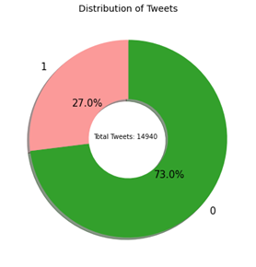
Result:
Out of the total of 14940 tweets done by the public on the Demonetization tweets 27.0% are Violent(positive) tweets and 73.0% are non-violent.
This shows us there are significant violent tweets in this category.
We are getting an accuracy 92%.
Graph:

Slide 31
Test case 05
Aim: Analysis of comments on Stock-market tweets and find the negative and positive comments. So that we can check whether that parent tweet is getting positive or negative feedback from the public to identify the cyberbullying case
Dataset: Dataset imported from Kaggle.com
Output:
Total No. of Tweets | Violent Tweets (in %) | Non-Violent Tweets
583 | 2.1% | 97.9%

Slide 32
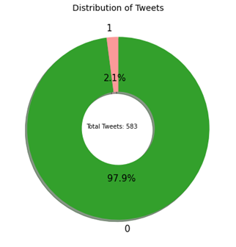
Result:
Out of the total of 14940 tweets done by the public on the Stock-market tweet 2.1% are Violent(positive) tweets and 97.9% are non-violent.
This shows us there are significant non-violent tweets in this category.
We are getting an accuracy 99%.
Graph:

Slide 33
CONCLUSION
We have developed an approach towards the detection of cyberbullying behaviour.
If we are able to successfully detect such posts which are not suitable for adolescents or teenagers, we can very effectively deal with the crimes that are committed using these platforms.
An approach is proposed for detecting and preventing Twitter cyberbullying using Supervised Binary classification Machine Learning algorithms.
Our model is evaluated on Naive Bayes, also for feature extraction, we used the TFIDF vectorizer.

Slide 34
FUTURE WORK
In future, it is possible to provide extensions or modifications to the proposed clustering and classification algorithms to achieve further increased performance.
Apart from the experimented combination of data mining techniques, further combinations and other clustering algorithms can be used to improve the detection accuracy and to reduce the rate offensive tweets.
Finally, the cyberbullying detection system can be extended as a prevention system to enhance the performance of the system.

Slide 35
REFERENCES
Ying Chen, Yilu Zhou, Sencun Zhu, and Heng Xu. “Detecting offensive language in social media to protect adolescent online safety”. In Privacy, Security, Risk and Trust (PASSAT), 2017 International Conference on and 2017 International Conference on Social Computing (SocialCom), pages 71– 80. IEEE, 2017.
K. Jedrzejewski and M. Morzy, “Opinion Mining and Social Networks: A Promising Match,” 2019 Int. Conf. Adv. Soc. Networks Anal. Min., pp. 599–604, Jul. 2019.
H. Hosseinmardi, S. A. Mattson, R. I. Rafiq, R. Han, Q. Lv, and S. Mishra, “Analyzing Labeled Cyberbullying Incidents on the Instagram Social Network.”
Kelly Reynolds, April Kontostathis, Lynne Edwards, "Using Machine Learning to Detect Cyberbullying”, 2020 10th International Conference on Machine Learning and Applications

Slide 36
Thank YOU…

